Slide 1
Team 55: National Firefighter Registry
In Collaboration with CDC-NIOSH
10/31/2020

Slide 2
Team 55: Personnel
Team 55 Members:
James Davis
Haolong Yan
Rahul Nowlakha
Joe Kurokawa
Traver Clifford
Eric Mammoser
CDC Mentors:
Jill Raudabaugh
Breanna Newton
GT Mentor:
Elizabeth Shivers

Slide 3
Agenda
JSON Parser Update
XML Parser Update
DB Update
Deployment Status
QA Update
Project Screenshots
Project Plan Update
Project Plan Details
Plans for Upcoming Weeks

Slide 4
JSON Parser Update
Fixed issue with NDJSON parsing on Docker container
This task is now completed
Notes:
References:
Health risks: https://www.cdc.gov/niosh/firefighters/health.html

Slide 5
XML Parser Update
This task is completed, nothing to report
Notes:
References:
Health risks: https://www.cdc.gov/niosh/firefighters/health.html

Slide 6
DB Update
Worked on mapping FHIR resource elements to database fields (partially complete)
Wrote initial DB insertion code for JSON
Addressed QA feedback on DB insertion code

Slide 7
Deployment Status
Per CDC’s direction, we are delivering a local solution hosted on a Docker container, not hosting through HDAP
Docker Container is up and running with both the Python code executing and MS SQL DB stood up
Able to access Docker SQL DB with appropriate port mapping via Tableau
One oddity: sometimes have to interactively rerun entrypoint.sh within Docker container to have our Firefighter DB created successfully

Slide 8
Deployment Details
Run docker build --tag nfr . from the app directory
Run docker run –p 80:1433 nfr
Can either add –it /bin/bash, or from Docker GUI launch CLI to get a bash shell
Within Docker:
To run test.sh:
cd test; /bin/bash test.sh
To run DB insertion code:
python3 FHIR_insertDB.py test/data/cdc_created/NFR_Firefighter_PatientResource.json
Within Tableau connect to localhost,80 with credentials sa/Password!123

Slide 9
QA Update
Initial QA of parsers implemented with all tests passing
Identified bug in NDJSON code when executed on Docker container (fixed)
Reviewed and fed back issues associated with DB insertion code

Slide 10
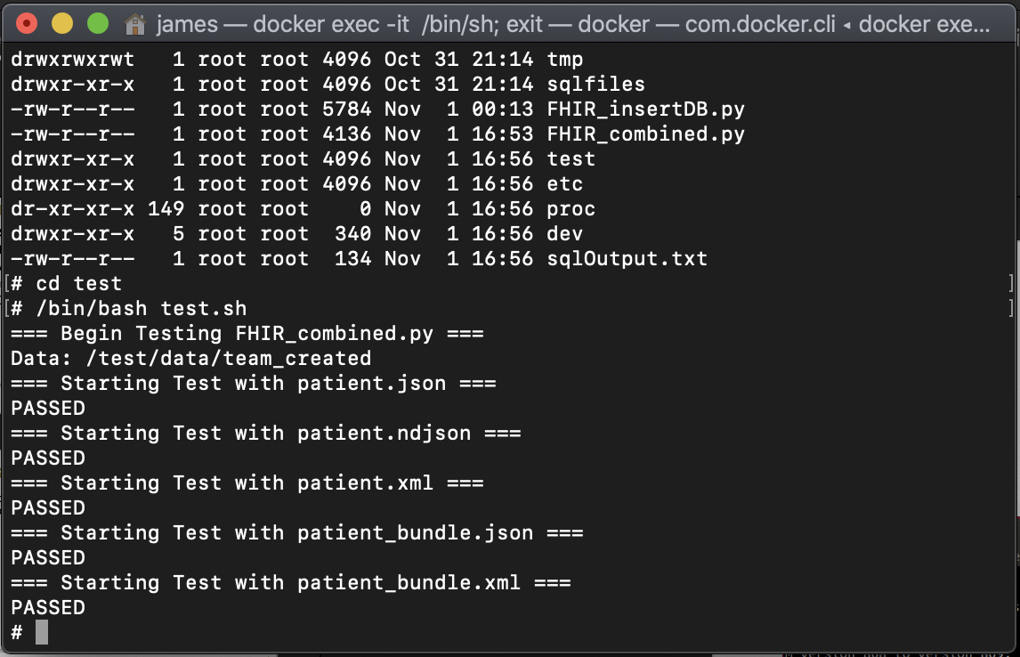
QA Screenshot
Docker test suite for each data format

Slide 11
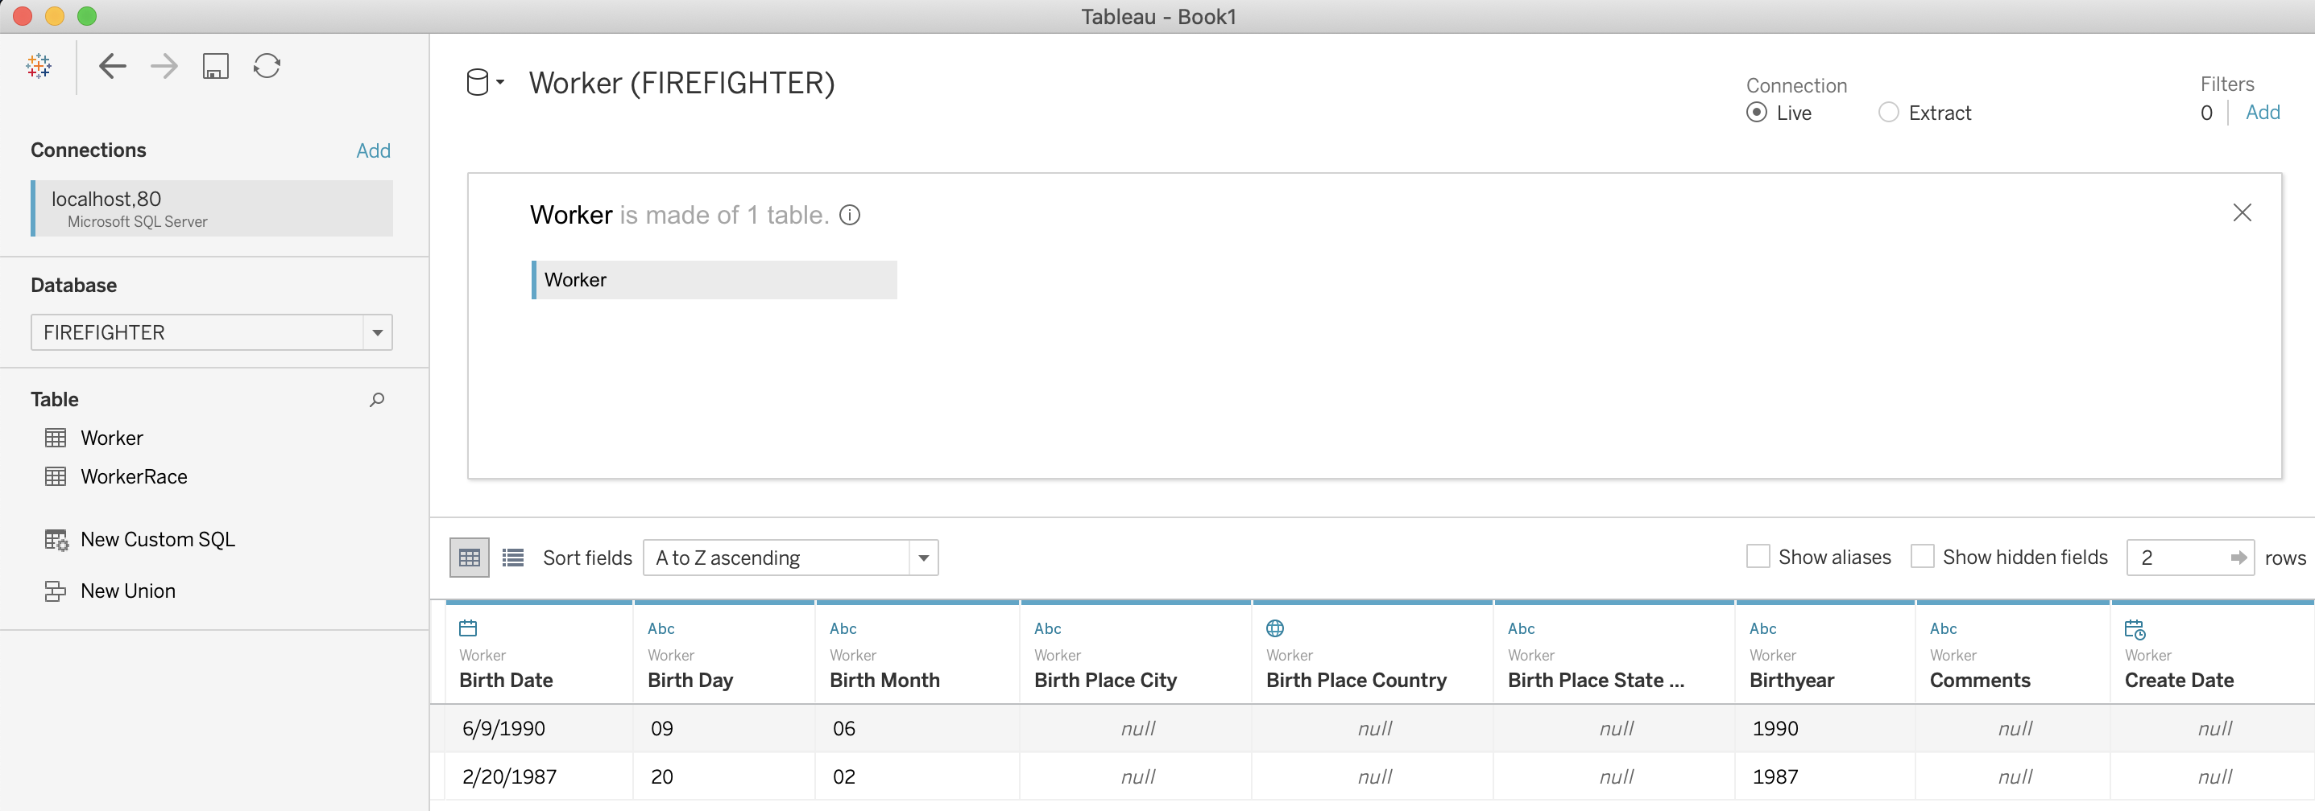
Tableau Screenshot
Below shows two patients: one from CDC, the other from HL7’s patient resource example

Slide 12
Project Plan Update

Slide 13
Project Plan Details
One week slip on JSON as we had to debug and fix NDJSON on Docker; closed this issue out
Anticipate the need to extend DB mapping by an extra week
Need to seek some clarification on CDC-provided fields from Jill
Only downstream dependency on this task is visualization, but CDC’s requested visualization only relies on the Patient’s fire department being known, so we can work this in parallel

Slide 14
Plans for Future Weeks
Continue mapping FHIR resources to DB fields to support DB population
Update DB insertion code to support XML data
Find more data sources (possibly from Jill) to insert into DB for visualization
Look into how to deliver local Tableau dashboard to CDC

